Slide 1


Mitron Bank: New Credit Card Line
Problem Statement : -
Mitron Bank, a legacy financial institution headquartered in Hyderabad, plans to launch a new line of credit cards to expand its product portfolio and strengthen its presence in the competitive financial services market. To ensure a successful launch, the bank seeks to leverage data analytics to understand customer demographics, spending behavior, credit risk, and market opportunities, enabling data-driven decisions for product design, targeting, and strategy.

Slide 2


PROJECT OBJECTIVES
Dataset Overview
I
II
Customers by Demographics
Analyze customer by demographics such as age,gender,city,occupancy patterns .
Dim_Customers
This dimension table contains customer-level information such as demographics, occupation, income group, and geographic attributes. It provides essential context to segment customers and analyze spending behavior across different customer profiles.
III
IV
Insights & Recommendation
Provide actionable insights & Recommendations through dashboards and reports.
Fact_Spends
This fact table captures detailed transaction-level spending data, including customer ID, transaction date, spend category, and amount spent. It serves as the core dataset for analyzing customer spending patterns, trends, and category-wise performance.
Spending & income
Analyze customer Income & spending patterns to design credit card features with lifestyle and usage behavior.

Slide 3
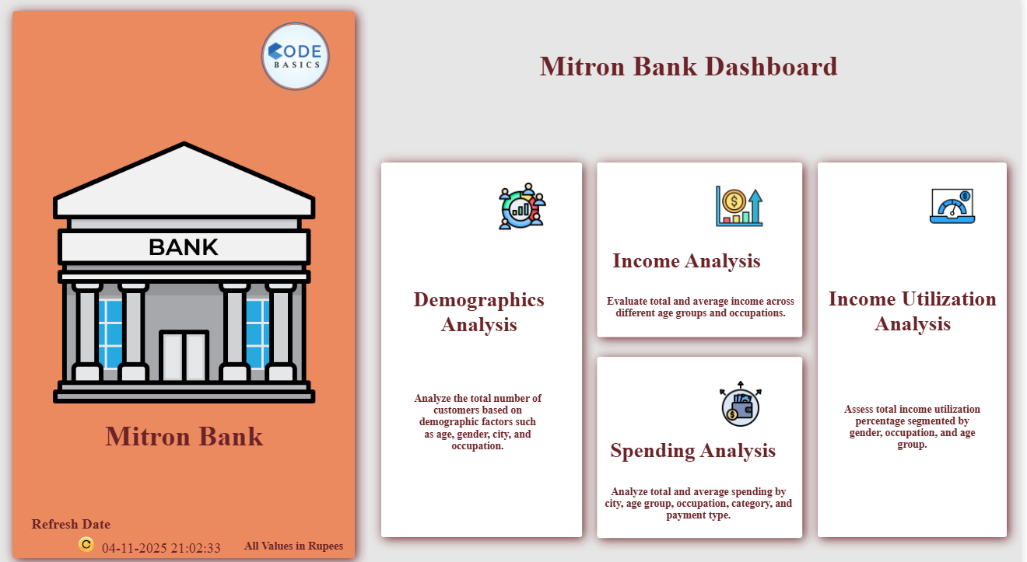

Slide 4
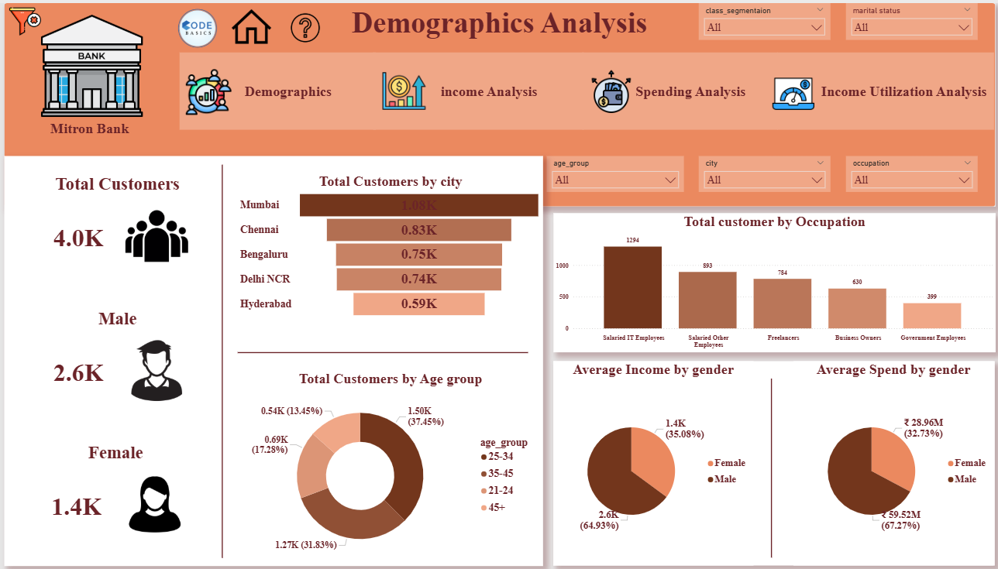

Slide 5
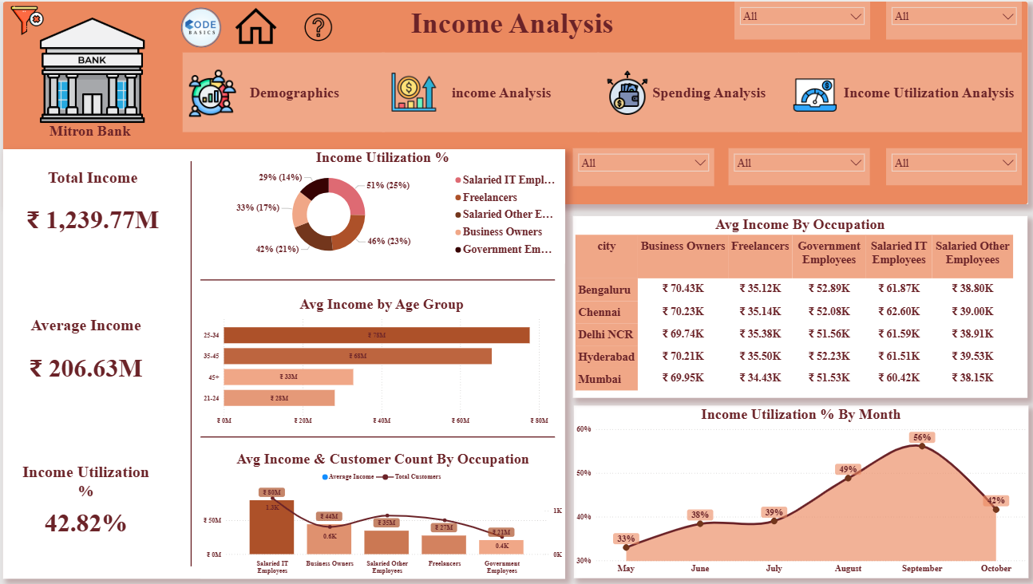

Slide 6
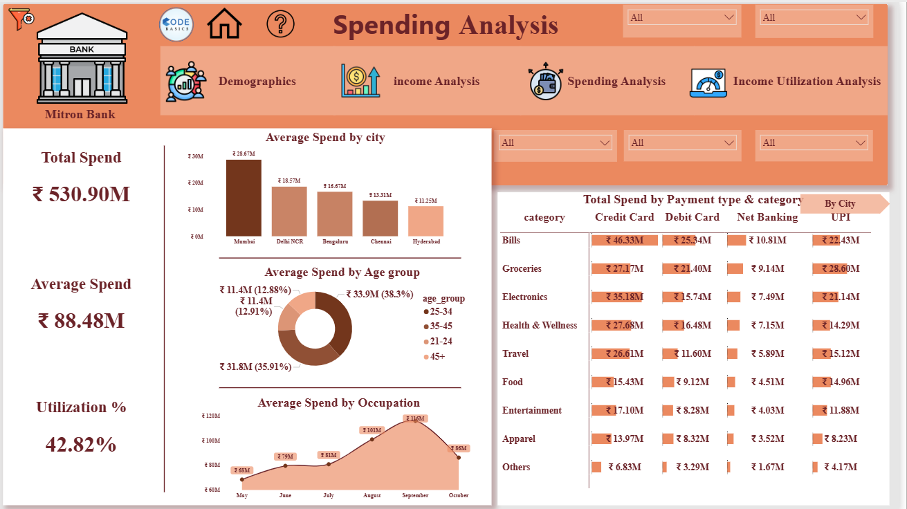

Slide 7
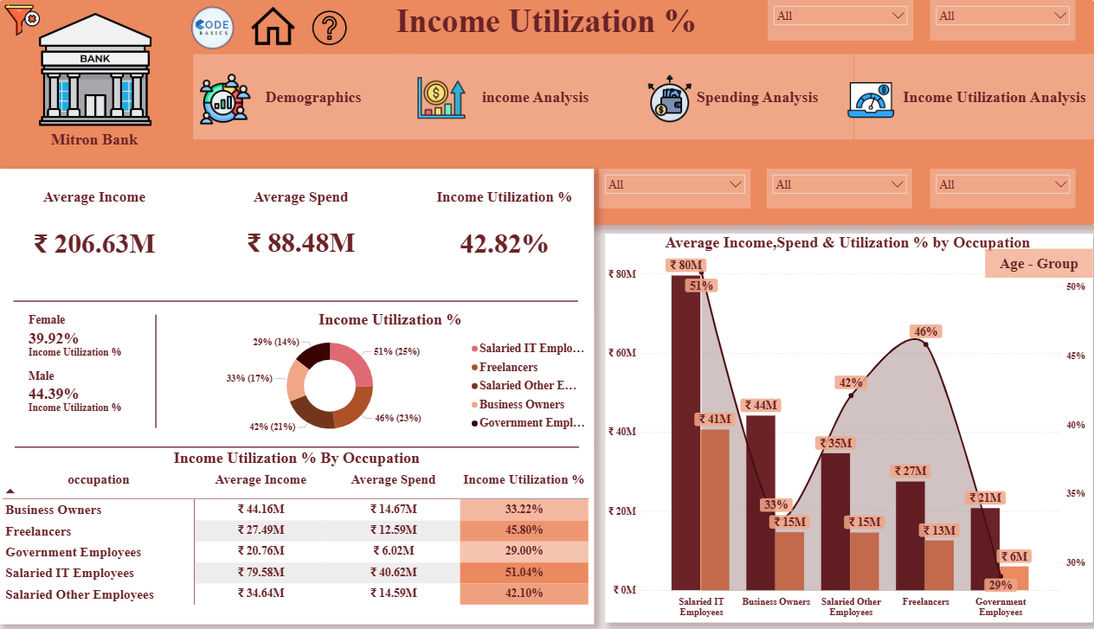

Slide 8
Insights
👤 Total Customers: 4K ♂️ Male: 65% | ♀️ Female: 35%
◆
🏙️ Customer Concentration: Mumbai leads the customer base, followed by Chennai, Bengaluru, and Delhi NCR.
🎂 Age Profile: Customers aged 25–45 form the largest and most active segment.
💼 Occupation Mix: Predominantly salaried IT professionals, followed by salaried non-IT employees and freelancers.
⚖️ Gender Insight: Male customers contribute a higher share of income and spending, while female customers exhibit more controlled and efficient spending patterns.
📊 The middle-class segment constitutes the largest share of customers, significantly higher than both the lower-middle-class and upper-middle-class segments, indicating a strong concentration of mass-market, income-stable customers.
🎂 Income by Age: Customers aged 25–34 and 35–45 generate the highest average income.
📆 Seasonality Insight: Income utilization peaks during August–September, reflecting seasonal spending patterns.
♂️ Male customers exhibit higher credit utilization than ♀️ female customers, indicating greater credit adoption and spending intensity.
High-utilization segments (Salaried IT and Freelancers) present immediate growth opportunities, while low-utilization, low-risk segments (Government Employees) offer scope for controlled credit expansion.
◆ ◆ ◆

Slide 9
Recommendations
◆
1. Primary Target Segment
Urban Salaried Professionals (25–45 years)
Cities: Mumbai, Bengaluru, Chennai, Delhi NCR
Occupations: Salaried IT & Salaried Other Employees
Recommended Card Type
👉 Lifestyle Rewards Credit Card
Features
Cashback on groceries, bills, and online shopping
Travel and dining reward points
EMI options on electronics
Moderate annual fee with waiver on spend threshold
4. Low-Risk Segment
Government Employees
Recommended Card Type
👉 Low-Interest Credit Card
Features
Lower interest rates
Conservative credit limits
Minimal annual fee
Ideal for long-term relationship building
2.Secondary Segment
Freelancers & Self-Employed
Recommended Card Type
👉 Flexible Spending Credit Card
Features
Higher credit utilization allowance
Flexible billing cycles
Rewards on digital payments & subscriptions
Instant credit limit enhancements
5. Age-Wise Customer Targeting Recommendations
Age 21–25: Starter Credit Card with low limits, cashback on essentials & online spending, and credit-building benefits for early adoption.
Age 26–35: Lifestyle Rewards Card offering cashback, travel & dining points, EMI options, and fee waivers to boost usage.
Age 36–45: Premium Lifestyle Card with higher limits, family-oriented rewards, travel benefits, and priority support to enhance loyalty.
Age 46–60: Low-Interest/Premium Card with conservative limits, minimal fees, and travel, wellness & insurance perks for secure, flexible credit.
3. Gender-Focused Opportunity
Women Customers (Underpenetrated Segment)
Strategy
Launch Women-Focused Rewards Card
Benefits on wellness, shopping, education, and travel
Higher reward multipliers on essential categories

Slide 10
Thank You

